Slide 1
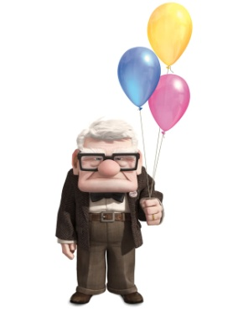
Super sentences

Slide 2
Super Sentences - The Process
Start with a boring sentence This sentence should be connected to the book/topic you are studying – ‘UP’
Look at different ways of changing sentence (match to the different techniques used)
Work collaboratively (with a partner) to improve a new sentence
Share some of your improved sentences
As a class choose which ways (or a combination of them) to come up with their super sentence

Slide 3
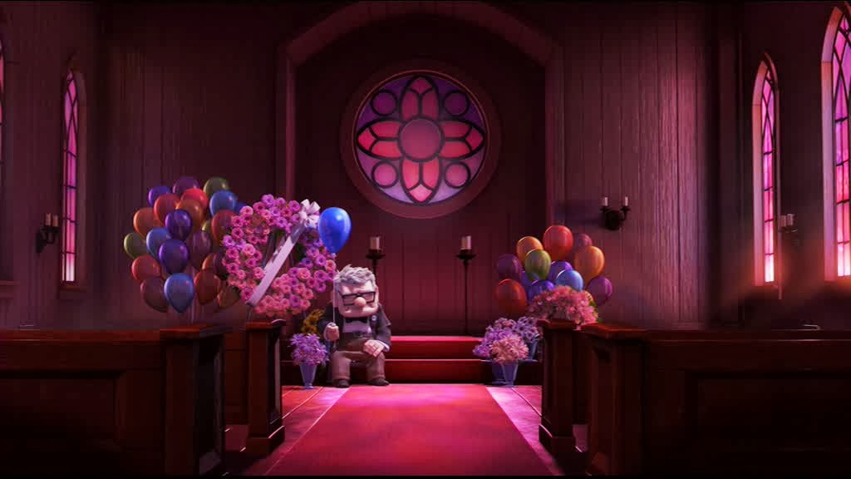

Slide 4
Improving sentences Carl was so sad when Ellie died.
Add figurative language
Carl was so sad when Ellie died it felt like his heart had been torn in two.
Carl was completely devastated when Ellie died.
Carl was so sad when Ellie died, he felt all alone in the world.
Use more ambitious language
Include a subordinate or embedded clause
Super Sentence
Carl was completely devastated when Ellie died, it was as though his heart had been torn in two, he felt all alone in the world.
.

Slide 5
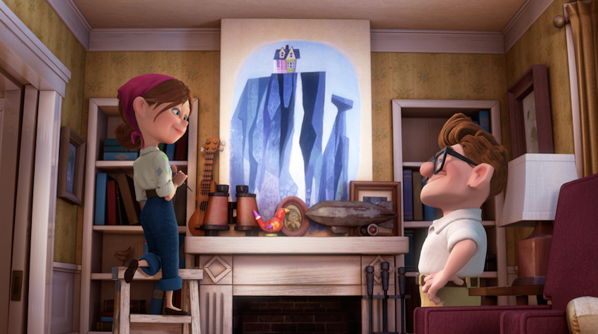

Slide 6
Improving sentences Carl and Ellie wanted to travel.
Add figurative language
1.
2.
3.
Use more ambitious language
Include a subordinate or embedded clause
Super Sentence

